Slide 1
eASy book
Reserve your place
Team Members :
2210030184 – B . Joshita
2210030222 – A . Sai Lakshmikanth
2210030225 – G . S . R . Hemanth

Slide 2
Introduction
Easy Book simplifies your ticket booking with a user-friendly platform. Quickly browse and secure tickets for transport, sports events, and more. Enjoy a smooth, secure booking process and real-time updates. With Easy Book, finding and managing your tickets has never been easier. Discover your next event effortlessly!

Slide 3
Tables
Type
Role
User
Admin

Slide 4
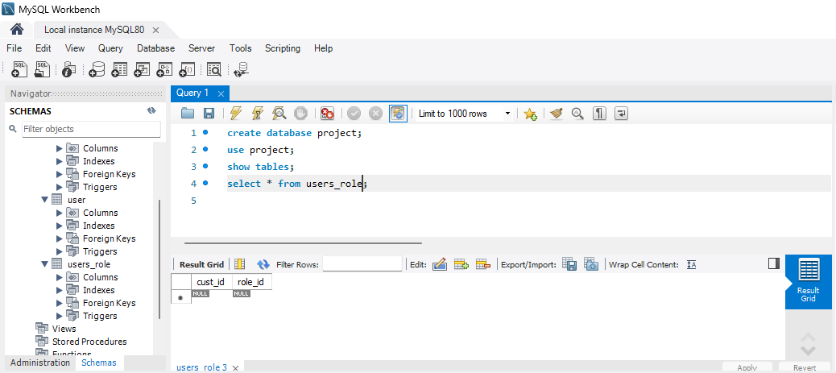
ROle

Slide 5
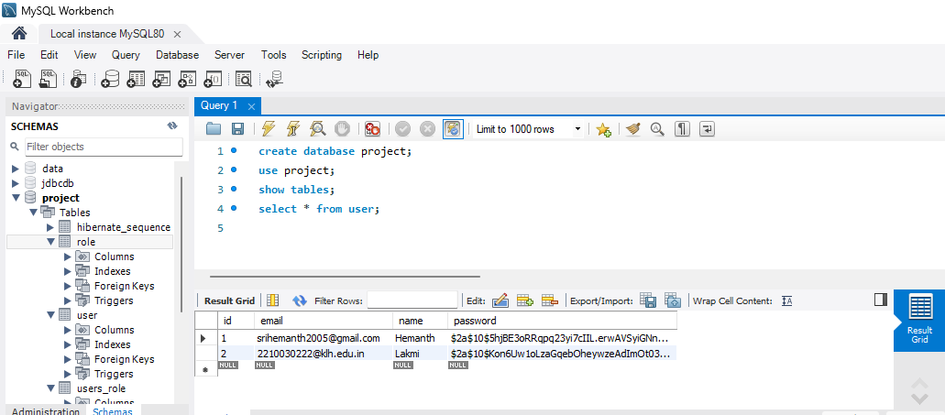
USER

Slide 6
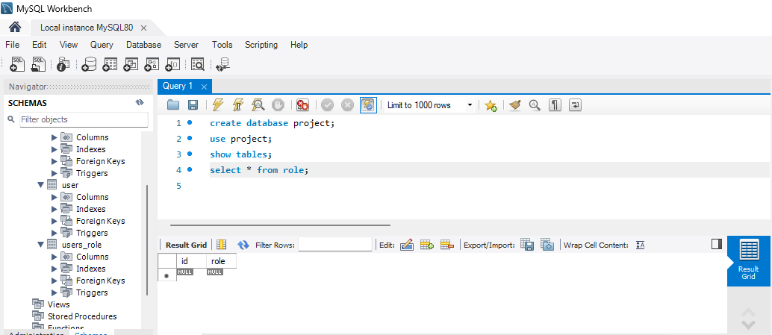
Admin

Slide 7
Thank You

